Slide 1
What is it?
Where Cyber Bullying happens
Cyber Bullying
Why do people think it’s okay?
Have you or a friend ever been in this situation?
How many people are affected by it?
How to stop the bullying!

Slide 2
What is cyber bullying?
????

Slide 3
Cyber Bullying is:
the use of information to negatively use against someone else by technologies.
the behavior of an individual or group to say things indirectly to purposely harm others.

Slide 4


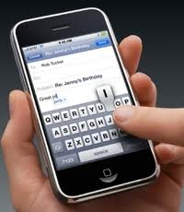



What kinds of technologies?
Look familiar???

Slide 5
Why do people think its okay?
reputation someone is trying to uphold
problems of their own
to make oneself feel better
RESULTS OF CYBER BULLYING…
depression AND anxiety
poor school attendance and performance
feeling fear
mistrust toward others.

Slide 6
THINK!!!
Have you ever been the one who was the bully, and not even know it?
How did it feel?
Have you or someone you know ever been in this situation?

Slide 7
How many people are affected by cyber bullying?
MIDDLE SCHOOL STUDENTS
4
have had their password(s):
stolen
changed by a bully
got
Locked out of their own account
or
sent communications posing as them
OUT OF
10

Slide 8
Amount of Kids BULLIED ONLINE!

Slide 10
How would you feel if you logged on to your computer, and this popped up?

Slide 11
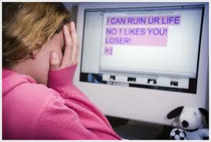

Slide 12
How to stop the bullying!
Stay positive towards people.
Find true friends, who you love being around and vice versa.
Don’t share personal information on online communication systems.
KNOW who you are talking to!

Slide 13
CYBER BULLYING

Slide 14


